Slide 1
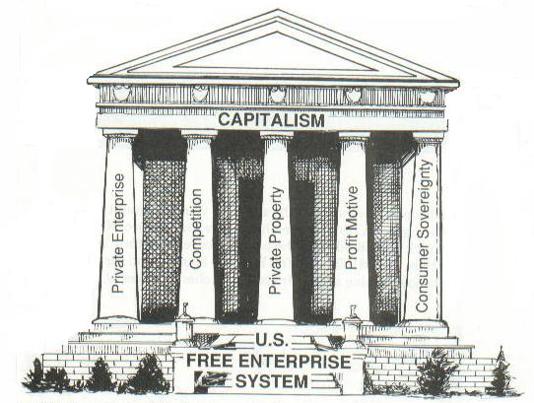
The American Free Enterprise System

Slide 3
Free Enterprise and the Constitution
The 5th Amendment:
“No person shall be deprived of life, liberty, or property without
due process of law: nor shall private property be taken for public
use without just compensation.”
Article 1, Section 10:
“No state shall … pass any … law impairing the
obligation of contracts”.

Slide 4
Free Enterprise and the Constitution, continued…
Article 1, Section 8:
“The Congress shall have power to lay and collect taxes, duties,
imposts and excises, to pay the debts and provide for the common
defense and general welfare of the United States…”
The 16th Amendment:
Empowers Congress to tax "incomes, from whatever source derived,
without apportionment among the several States, and without regard
to any census or enumeration."

Slide 5
The Constitution itself promotes innovation by the establishment of patents, copyrights, and trademarks.
Article 1 Section 8: Congress has the power to “promote the progress of science and useful arts, by securing for limited times to authors and inventors the exclusive right to their writings and discoveries.

Slide 6
Basic Principles of Free Enterprise
Profit Motive
Business owners decide how to run their businesses. They will want to make decisions which maximize profits, so acting responsibly while also being innovative.
Open Opportunity
Concept that everyone can compete in the marketplace-
there is “mobility” up or down depending on the success of your business
Economic Rights
Rights of…
1-Legal equality- everyone has the same rights
2-Private property- you decide what to do with your property
3-Free contract- you decide what agreements you want to enter into.
4-Voluntary exchange- you decide what and when you want to sell
These rights promote competition, the
rivalry among sellers to attract customers

Slide 7
The Role of Government
Constitution requires government to protect property rights, contracts, and other business activities. Though not explicitly stated, many Americans expect protection from such things as pollution and unsafe foods.
Government has an important role to play in making sure consumers are provided with correct information from producers. It serves to protect consumers from dangerous products and services, and to stop businesses from making fraudulent claims. Public disclosure laws require companies to provide consumers important information about their products.
Starting in the 1960’s, the government has played a much larger role in protecting the health, safety, and welfare of the public through regulations affect such industries as automobile manufacturing and pharmaceuticals. These consumer protection also include requiring labels on consumer packaging that provide important information
There has been push-back by corporations that claim regulations are costly to implement, cut into profits, slow economic growth, and reduce competition.

Slide 10
Macro vs. Micro, yo!
Microeconomics: the study of economic behavior and decision-making. Deals with small units like individuals, households, and businesses (which can be rather large)
Macroeconomics: the study of the behavior and decision-making of entire economies, like that of the USA. Examines major trends of the entire economy
When looking at a whole economy, one important measure is Gross Domestic Product or GDP, the total value of all goods and services produced in an economy.
The GDP and other key statistics are monitored by economists to predict business cycles, which are periods of macroeconomic contraction and expansion. Free enterprise systems are subject to business cycles, so the government tries to prevent wild swings in economic behavior through public policy decisions.

Slide 11
Nominal GDP (as in total GDP by country)

Slide 12
GDP per capita (per person, that is)

Slide 13
Public Policy Attempts To Strengthen The Economy- Three Main Outcomes Are Pursued:
Employment- providing jobs for everyone who is able to work. An unemployment rate of 4-6% is generally considered desirable.
Growth- for each new generation of Americans to have a higher standard of living, there must be economic growth. One measure of growth is GDP
Stability- security and stability gives consumers and producers confidence in the system. One indicator of stability is the general price level. Major fluctuations make planning for the future difficult. Another sign of stability is the health of the nation’s financial institutions. The federal government therefore monitors and regulates the banks and other financial institutions.

Slide 14
Technology and Productivity
Work Ethic- commitment to the value of work and purposeful activity
Technological Progress- with technology being the process used to produce goods and services. Improvements in technology allow an economy to produce more output from the same amount of input (resources). Due to technological progress, the GDP rises as the economy operates more efficiently and productively.
US history provides many examples of technological innovation, such as Edison’s light bulb and Alexander Graham Bell’s telephone. The development of machines like the weaving loom, the tractor, and the computer have allowed us to generate more goods in a shorter time with fewer raw materials.

Slide 16
Government’s Role in Innnovation
Federal agencies fund many research and development projects at universities.
Land grant colleges have long existed to study agriculture and the mechanical arts. These include Florida A&M University, as well as the Massachusetts Institute of Technology (MIT).
The government’s own research institutions also produce new technologies. NASA, for example, has generated many spin-off technologies in its quest for space exploration.
The Internet started with the Defense Department’s ARPANET project- the federal government directly funded the creation of the Internet we know today.

Slide 17
Public Goods
Paul Samuelson was the first economist to discuss the concept of “public goods”. He described them as “goods which all enjoy in common in the sense that each individual's consumption of such a good leads to no subtractions from any other individual's consumption of that good...
A “public good” is a good or service for which
it would be inefficient or impractical to:
make consumers pay individually
exclude nonpayers (anyone can use it)
Examples: national defense, roads, street lights,
public parks, a dam, space exploration, clean air, fireworks…

Slide 20
Government steps in when the benefits of a policy outweigh the costs
When a good or service is public:
The benefit to each individual is less than the cost each would have to pay if it were provided privately, and
The total benefits to society are greater than the total cost.
In such circumstances, the market would not provide the good.
Public goods are provided by the “public sector”, where government transactions occur. The private sector has little incentive to produce public goods.

Slide 21
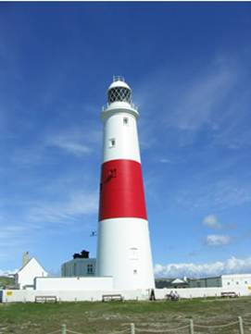
The FREE-RIDER PROBLEM
A free rider is someone who would not choose to pay for a certain good or service, but would get the benefits of it anyway if it were provided as a public good. The free rider problem suggests that if the government stopped collecting taxes and relied on voluntary contributions, many public services would have to be eliminated.
Examples: roads or fire protection
MARKET FAILURES
Free-riders are examples of a market failure, a situation
in which the market, on its own, does not distribute
resources efficiently. For example, private firms would not build roads in lightly populated areas because the profits are just not there.

Slide 22
EXTERNALITIES
An externality is an economic side effect of a good or service that generates costs or benefits to someone other than the person deciding how much to produce or consume.
Positive Externalities
Public goods generate benefits to many people, not just those paying for them. The private sector of the economy also generate positive externalities. If I buy a run-down house and fix it up, this generates positive benefits for my neighbors.
Negative Externalities
Part of the cost of producing a good or service is paid for by someone other than the producer. For example, a paper mill dumps waste in a river causing pollution that must be cleaned up by people living downstream. Or, your neighbor plays loud music at night, and you must listen to it.

Slide 23
A negative externality is a cost that is suffered by a third party as a result of an economic transaction. In a transaction, the producer and consumer are the first and second parties, and third parties include any individual, organization, property owner, or resource that is indirectly affected.

Slide 24
Government’s Goals
If externalities are present, then there is market failure because costs or benefits of a good or service are not assigned correctly.
Government encourages the creation of positive externalities. Education, for example, benefits not only students, but society as a whole. If government builds a mass transit system, this reduces congestion and pollution, benefiting everyone in the city regardless of whether they use it.

Slide 25
Negative Externalities: The government tries to limit negative externalities such as acid rain, which comes from auto emissions and coal-burning power plants. The cost of this pollution includes the affect people’s health, and damage to the environment. To deal with this negative externality, the federal government requires cars to have anti-pollution devices called catalytic converters. Power plants are required to install “scrubbers” on smokestacks to reduce harmful emissions. Another way to deal with power plant emissions is for the government to issue “pollution permits” that allow a specified amount of pollution, with the total for the industry kept within a defined limit. These permits can be traded between firms, but the total pollution allowed is limited.

Slide 26
PROVIDING A SAFETY NET
The free market is a successful system for generating wealth, but this wealth is not spread evenly throughout society. Due to economic factors like lack of jobs and few educational opportunities, the standard of living for some areas is below what is called the poverty threshold, an income level that is needed to support a individuals or a famil.
In 2015, the poverty threshold for:
an individual is $11,770
a single parent with one child is $15,930
a family of four is $24,250

Slide 27
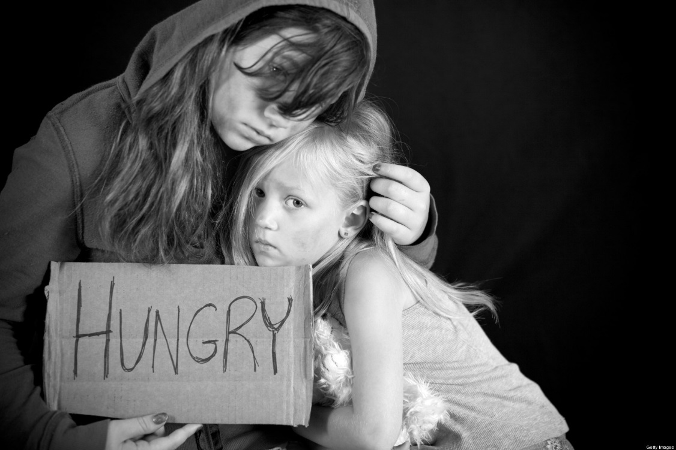
What can be done for the young, old, sick, poor, or disabled in a society when they cannot obtain needed goods and services?
Our economic system calls for limited government, so there are tough questions to grapple with:
What can the government do to combat poverty
What should it do?
Is government regulation
the best way to help
the poor?

Slide 28
THE WELFARE SYSTEM
Welfare refers to government aid to the poor. By collecting taxes and redistributing some of those funds, our society attempts to loosen the grip of poverty on Americans. Our welfare system began during the 1930’s with President Roosevelt’s attempt to deal with effects of the Great Depression, and was later expanded by President Lyndon Johnson in the 1960’s.
The New Deal programs of the 1930’s
The War on Poverty in the 1960’s
Welfare payments rose dramatically through the years, and by the 1990’s critics demanded changes to deal with people’s dependency on welfare.
Critics argued that income redistribution discourages productivity and actually makes poverty worse.

Slide 30
REDISTRIBUTION PROGRAMS
Cash Transfers: direct payments to the poor, disabled, and retired people by state and federal governments
TANF- Temporary Assistance to Needy Families. Begun in the 1990’s, this program shifted federal money to states to design and run welfare systems, the stated goal being to move people from welfare back to work.
Social Security- created during the Great Depression when many elderly lost their life savings, SS provides cash transfers of retirement income to the elderly and living expenses to disabled Americans. Money for this program is collected through payroll taxes, then redistributed…
Unemployment Insurance- a cash transfer funded by both federal and state funds providing unemployment compensation checks to eligible workers who have lost their jobs. Workers must show they are attempting to find work.
Workers’ Compensation- a cash transfer of state funds to those injured on the job. Employers pay “workers’ comp” insurance to cover claims by employees. The cost for this has risen greatly due to skyrocketing medical costs.

Slide 31
REDISTRIBUTION PROGRAMS, cont…
Cash Transfers: direct payments to the poor, disabled, and retired people by state and federal governments
In-Kind Benefits: goods and services provided for free or at reduced prices. These include food stamps, subsidized housing, legal aid, etc.
Medical Benefits: the US government provides health insurance for the elderly, disabled, and poor through the Social Security program. One component, Medicare, covers Americans over age 65, as well as disabled persons; another, Medicaid, covers poor people who are unemployed or not covered by employer’s insurance.
Education: federal, state, and local programs provide educational opportunities from pre-school to college and vocational programs. These programs contribute to the nation’s human capital and the productivity of the labor force.
Faith-Based Initiatives: religious organizations have been successful in delivering needed services. As part of an initiative by President Bush in 2003, these groups can compete for federal funds.
Over 40% of the federal budget goes to spending on Social Security, including Medicare and Medicaid.

